Slide 1
Multilayer Perceptron
http://bit.ly/2Hvf7yG

Slide 2
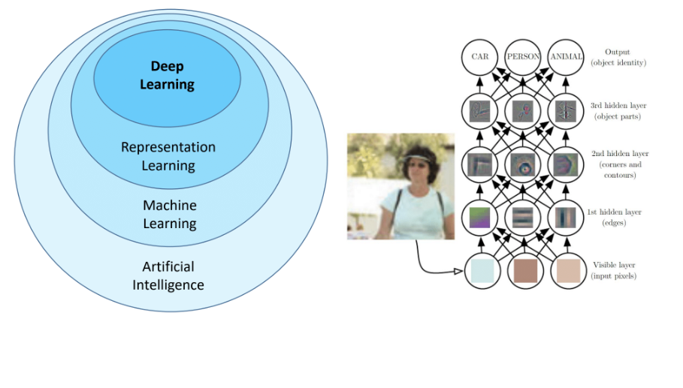
What is Deep Learning
The learning of representations

Slide 3
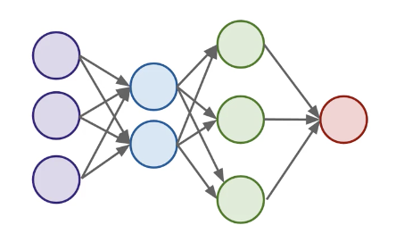
Why Neural Networks?
?

Slide 4
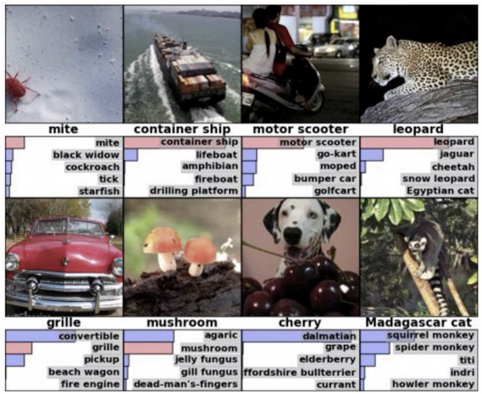
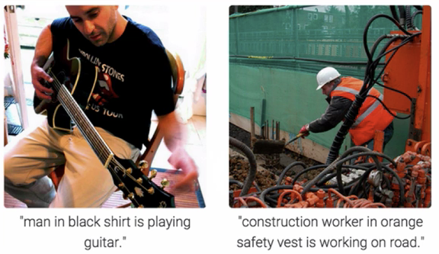
Object Recognition and Caption

Slide 5

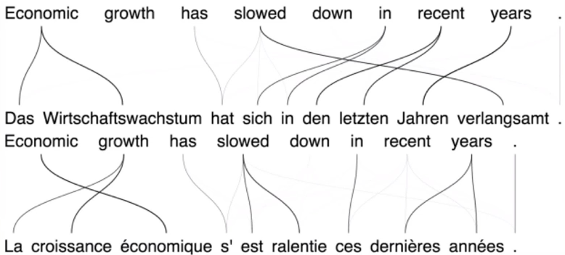
Neural Machine Translation

Slide 6
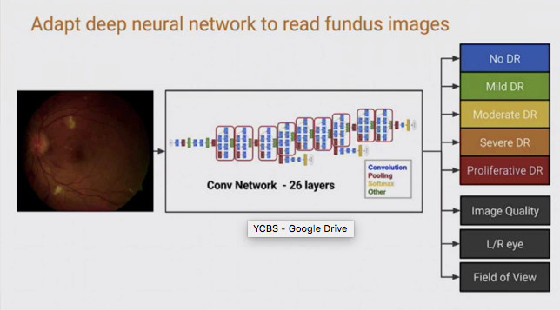
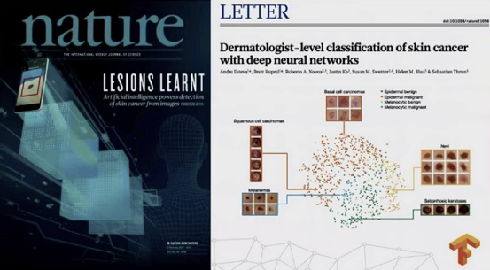
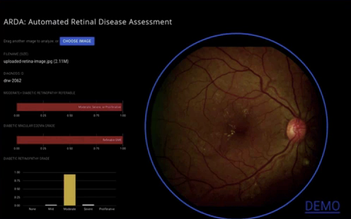
Medical Imaging / Diagnostic

Slide 7
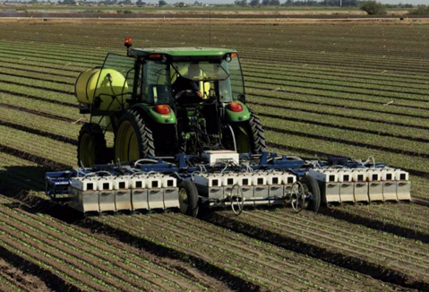
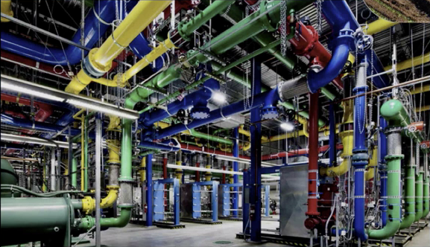
Cooling Data Center
Optimizing Agriculture yields

Slide 8
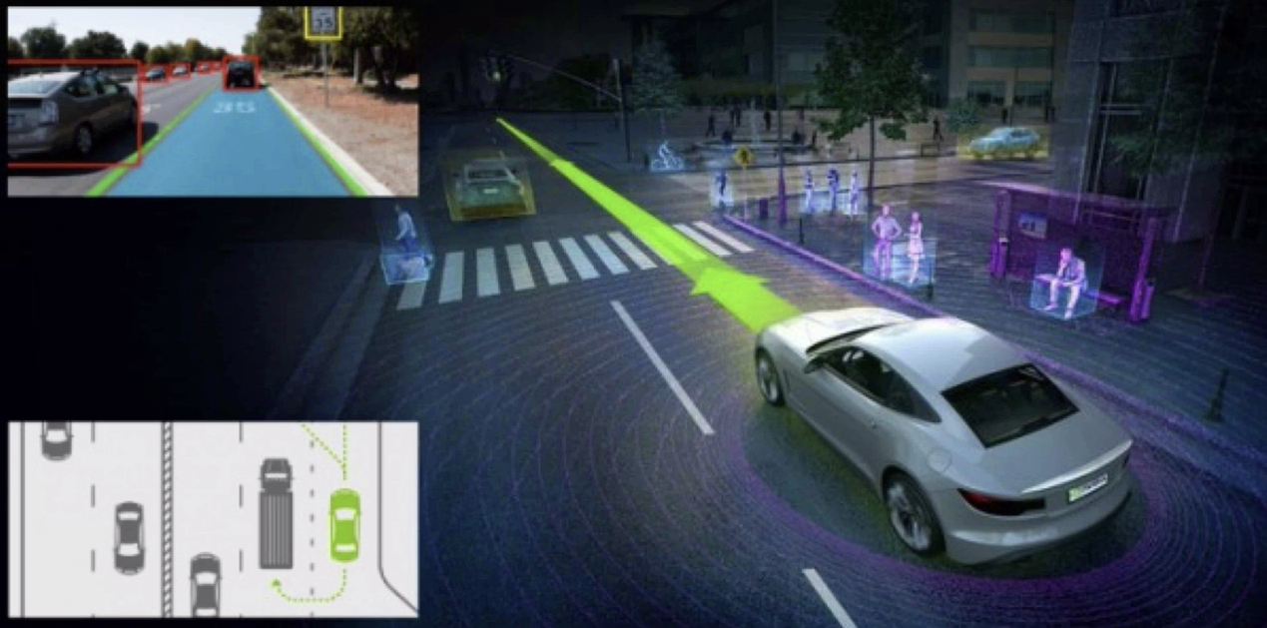
Self-Driving Cars

Slide 9
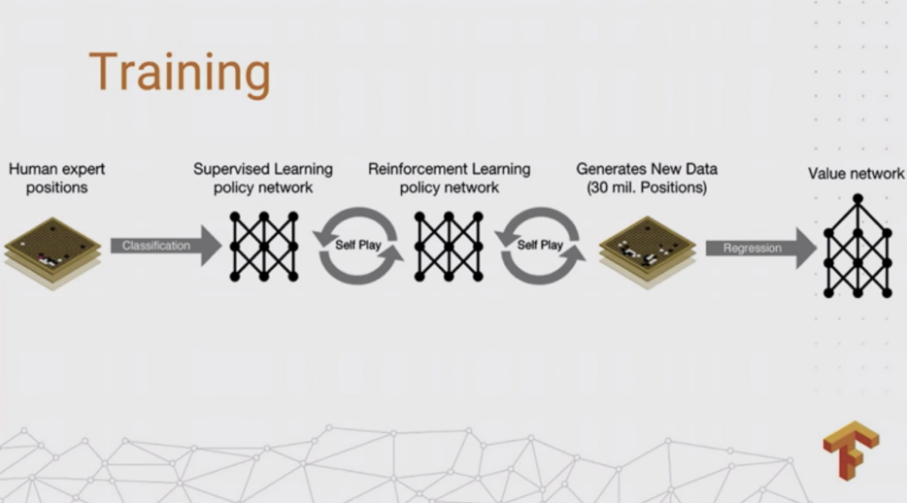
Alpha Go

Slide 10

Speech and Image Synth

Slide 11
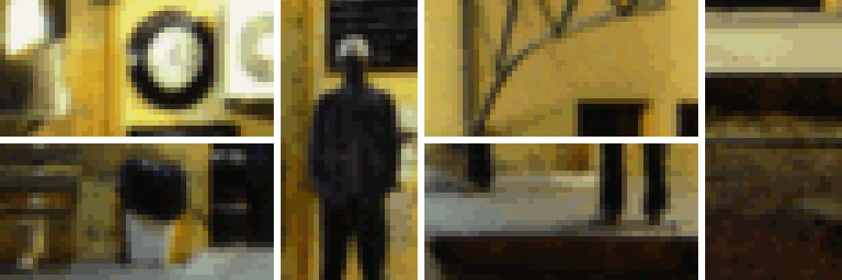
Enhance! (link)

Slide 12

Lipreading

Slide 13
Aside from that…
Businesses use DNN’s for
Decision making on similar data
Decision Making
Diagnostics
Identifying anomalies
Classification: fraud, CRM, Tagging, Text, Responding to events, Marketing, Recommendations, Spam
Regression: Valuation, Timing, Correlations, Requirements
Forecasting trends/events
System / Process / Parameter optimization
“Gloried Curve Fitting”
Judea Pearl
(link)

Slide 14
A Brief History of Deep Learning
1943: Neural networks
1957: Perceptron Algorithm
1984: Backpropagation, Boltzman Machines, RNN
1989: Convolutional Neural Networks
1997: Long Short Term Memory Networks
2006: Deep Learning, Deep Belief Networks
2009: Imagnet
2012: Alexnet wins Imagenet, Dropout
2014: Generative Adversarial Neural Networks
2016: Alpha GO
2017: Alpha Zero, Attention Networks
2018: BERT

Slide 15
A Brief History of Deep Learning Tools
1960: Mark 1 Perceptron
2002: Torch
2007: CUDA
2008: Theano
2014: Caffe
2015: Tensorflow 0.1
2015: Keras
2017: Pytorch 0.1
2017: Tensorflow 1.0
2017: Pytorch 1.0
2019: Tensorflow 2.0

Slide 16
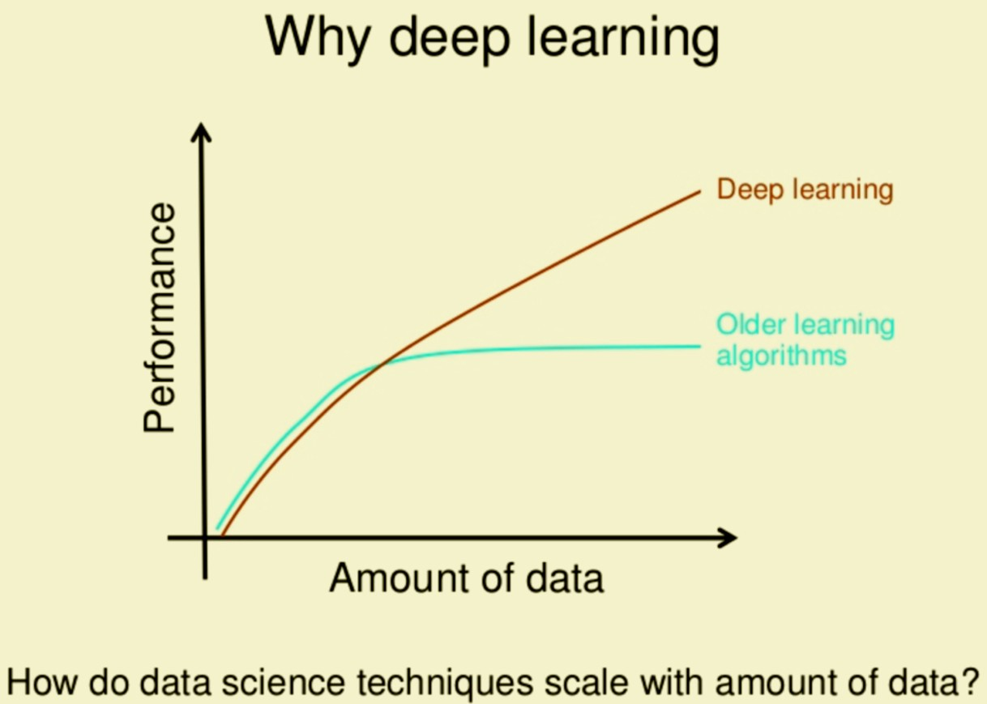

But Why? (oversimplification)
Deep Learning | Traditional ML
Input Model Output | Input Feature Extraction Features Model Output
*think no free lunch

Slide 17
So why DL?
It works for complex unstructured problems like images, videos, audio, time series and games
Performance with more data
Auto feature, no/little domain expertise needed

Slide 18
A review of the Perceptron

Slide 19
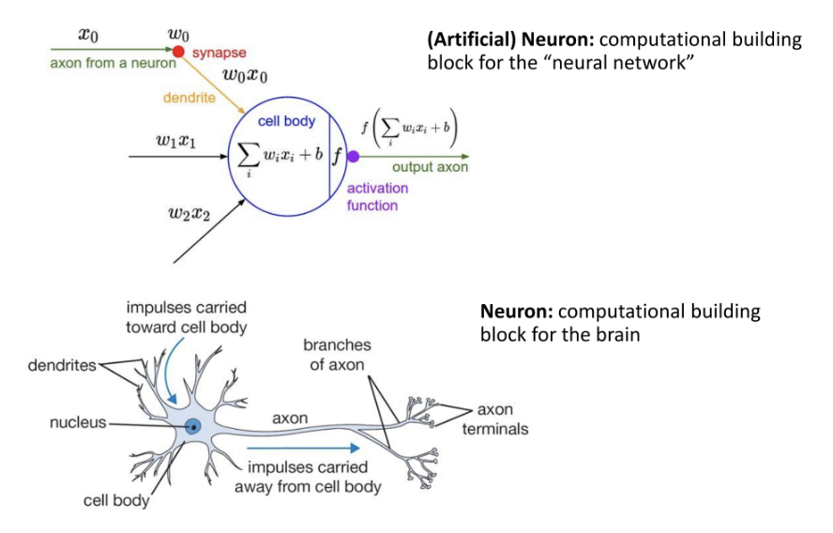
The Neuron

Slide 20
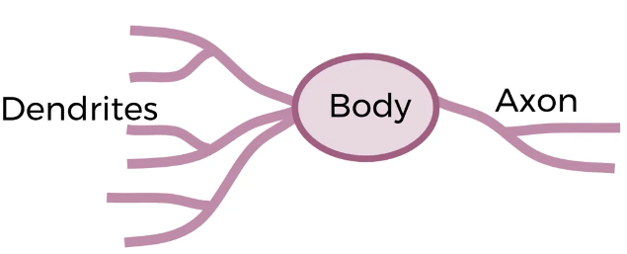
Biological Neuron

Slide 21
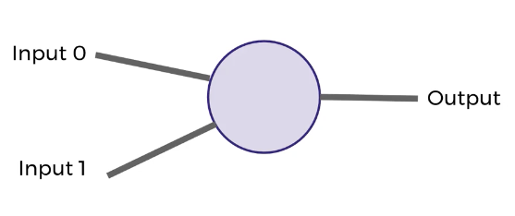
Conceptually

Slide 22
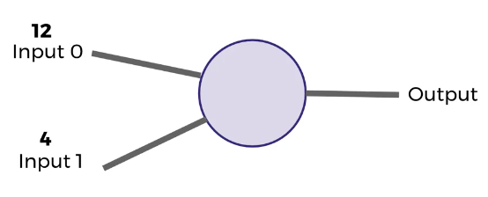
The dendrites receive an input

Slide 23
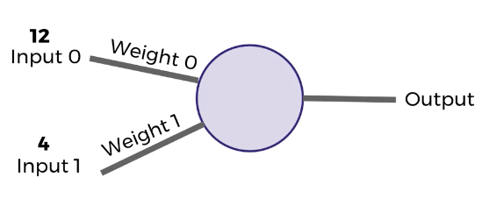
They inputs are subject to a weight

Slide 24
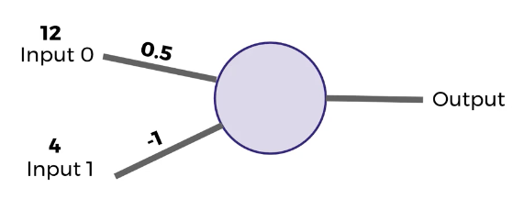
In the weights are initially give some value

Slide 25
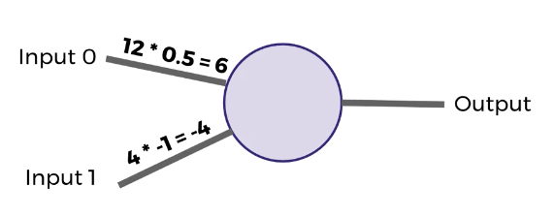
The inputs are multiplied by the weights

Slide 26
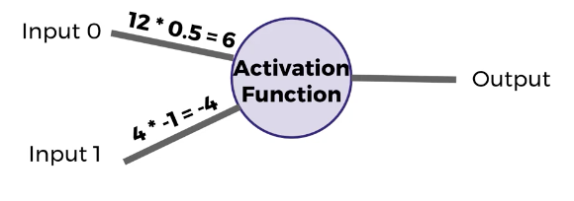
An Activation Function defines how to combine the inputs*weights and what will be passed on

Slide 27
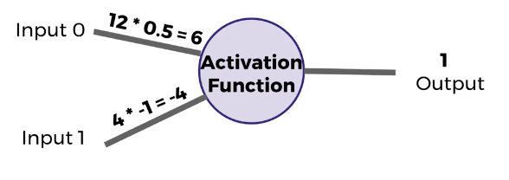
Simple AF: If positive, return 1, otherwise return 0

Slide 28
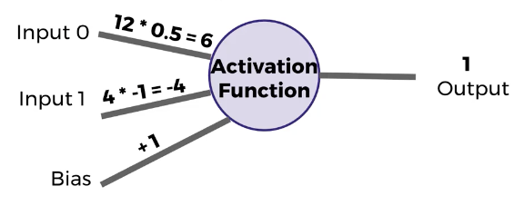
Add bias, so even if weights are both 0, we still can obtain a non-zero output

Slide 29
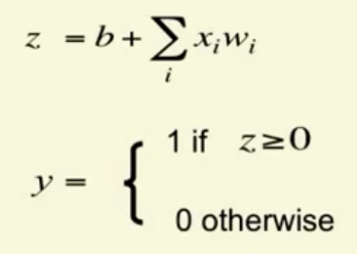
Simple Formulas, Sum of products and binary activation

Slide 30
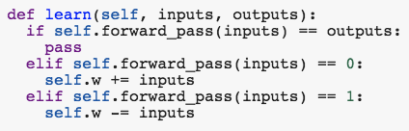
Perceptron Learning Algorithm
If the output is correct, leave weights alone
If the output unit incorrectly outputs a 0, add the input vector to the weight vector
If the output unit incorrectly outputs a 1, subtract the input vector from the weight vector

Slide 31
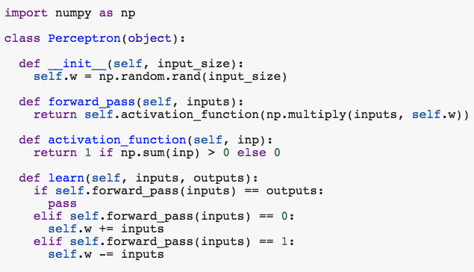
In code (link)

Slide 32
Neural Networks
Topology
Activation Functions
Loss
Optimizer
Back-propagation

Slide 33
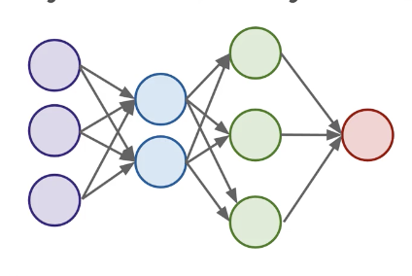
Input - Hidden Layers - Output

Slide 34
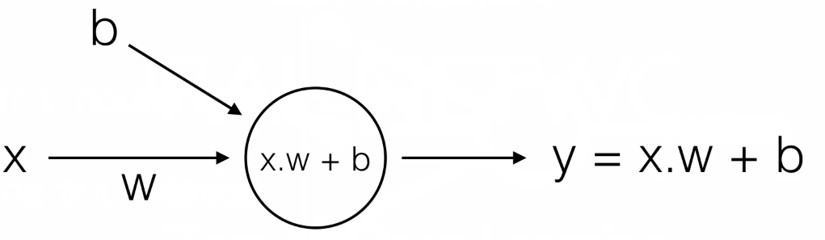
Neural Network with one layer and one unit (AKA linear regression)

Slide 35
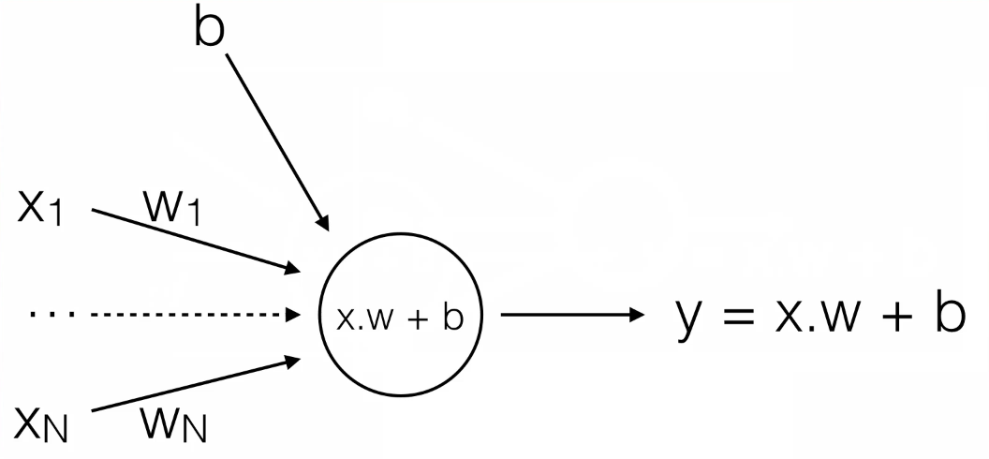
Multivariate Linear Regression
(Nothing New Here?)

Slide 36
What About Logistic Regression?

Slide 37
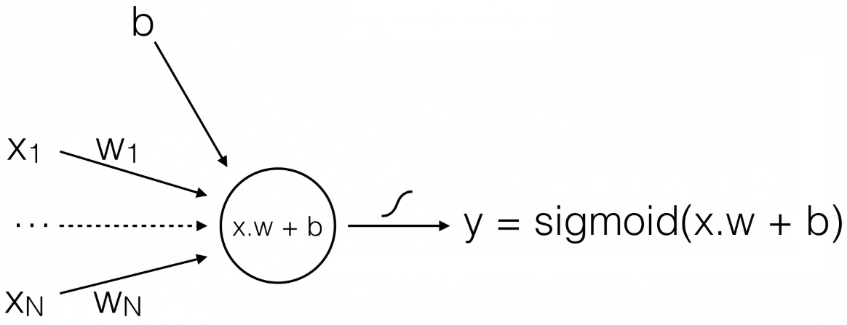
Just add a sigmoid and now we have Logistic Regression (binary output)

Slide 38
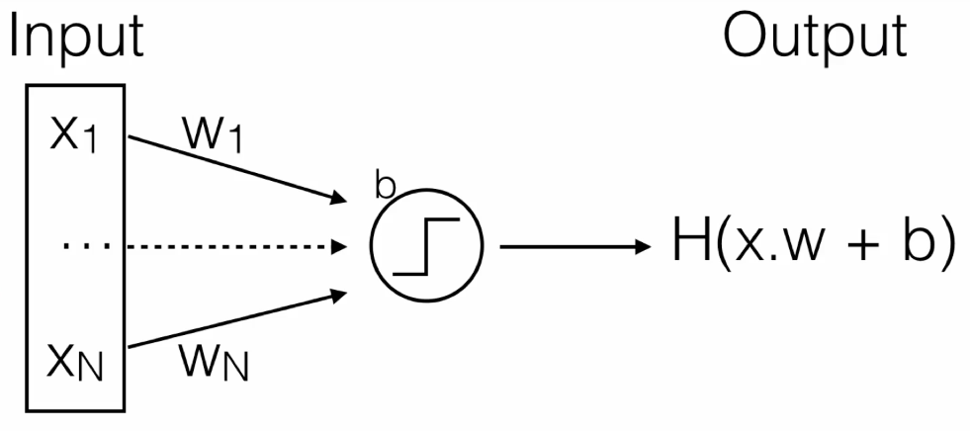
One Unit

Slide 39
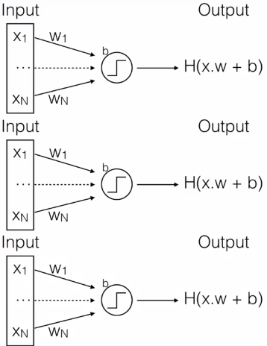
One Layer

Slide 40
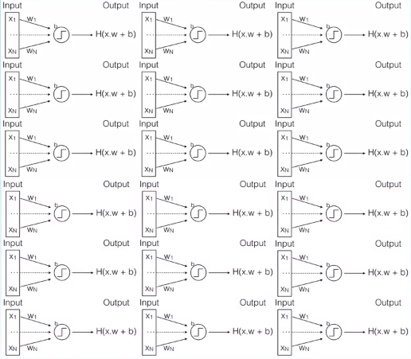
Multiple Layer

Slide 41
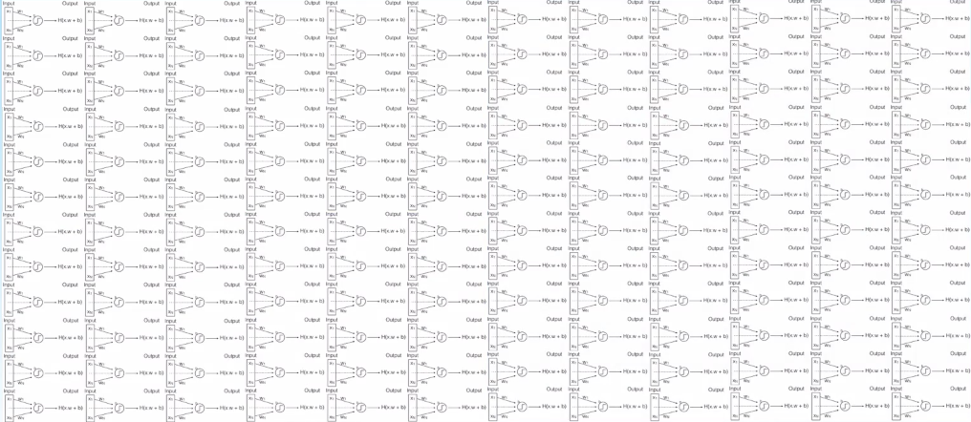
And so on...

Slide 42
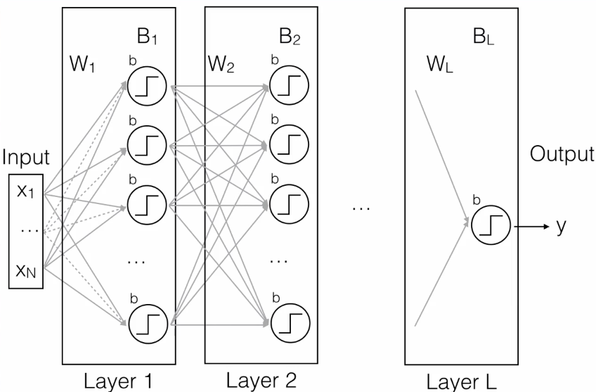
Each node in each layer is fully connected
Just one big f(x)=y
Takes inputs from a feature space and maps onto a target space. Same as all ML models
Multiply previous layer output by weights
Deform them with a nonlinearity
Pass transformed values along to next layer
And so on

Slide 43
Activation Functions
Defines the output of the node or neuron. This output is used as input for the next node
It maps the resulting values into the desired range using a simple function

Slide 44


Slide 45
Which one should we choose?
Most popular
Sigmoid or logistic
Tanh - hyperbolic tangent
ReLu - Rectified Linear Unit

Slide 46
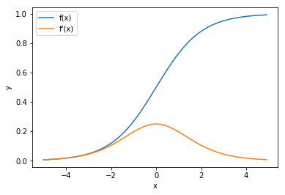
Sigmoid
It looks like the step function, but allows us to take into account small changes.
The original NN cost function
Vanishing Gradient, (degrading derivative) derivatives are too small
Requires initialization
Doesn’t work in large networks
Saturates and kills gradients
Slow convergence

Slide 47
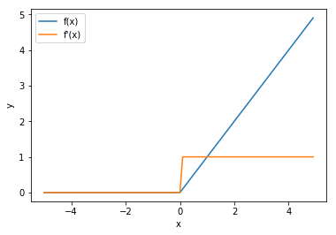
ReLu
Rectified Linear Unit
Max(0,x)
Most popular AF
Very simple and fast to calculate while staying non-linear
Derivative is fast to calculate and doesn’t degrade
Can sometimes “kill” neurons when always 0 derivatives

Slide 48
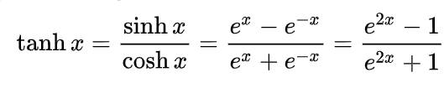
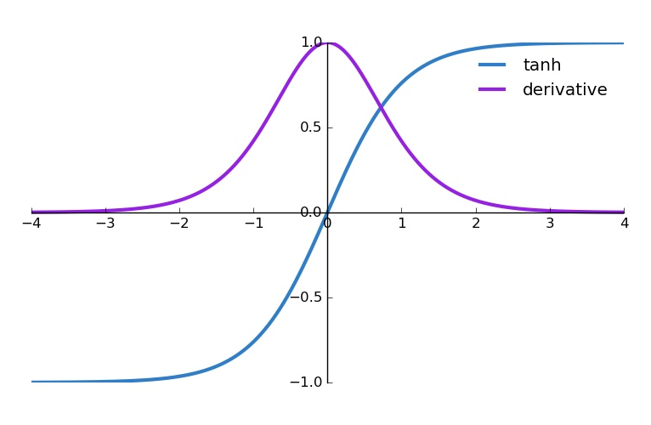
Tanh
Similar in most ways to the sigmoid
But is zero-centered, so easier to optimize
But still suffers from ...

Slide 49
Loss/Cost
How far off we are from the expected value, How wrong is my neural network (or my model in general)?
What are some examples of loss functions?

Slide 50
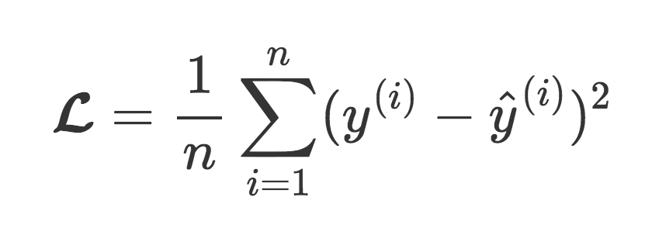
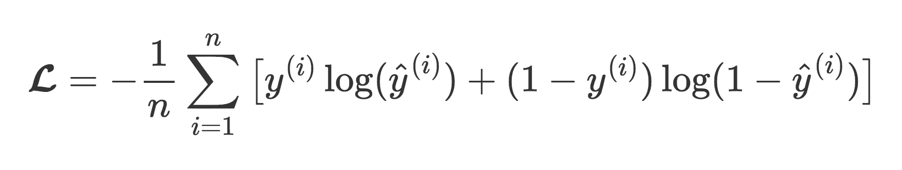
Types of Loss
Mean Square Error - Regression problems:
Categorical Cross Entropy - Classification problems:

Slide 51
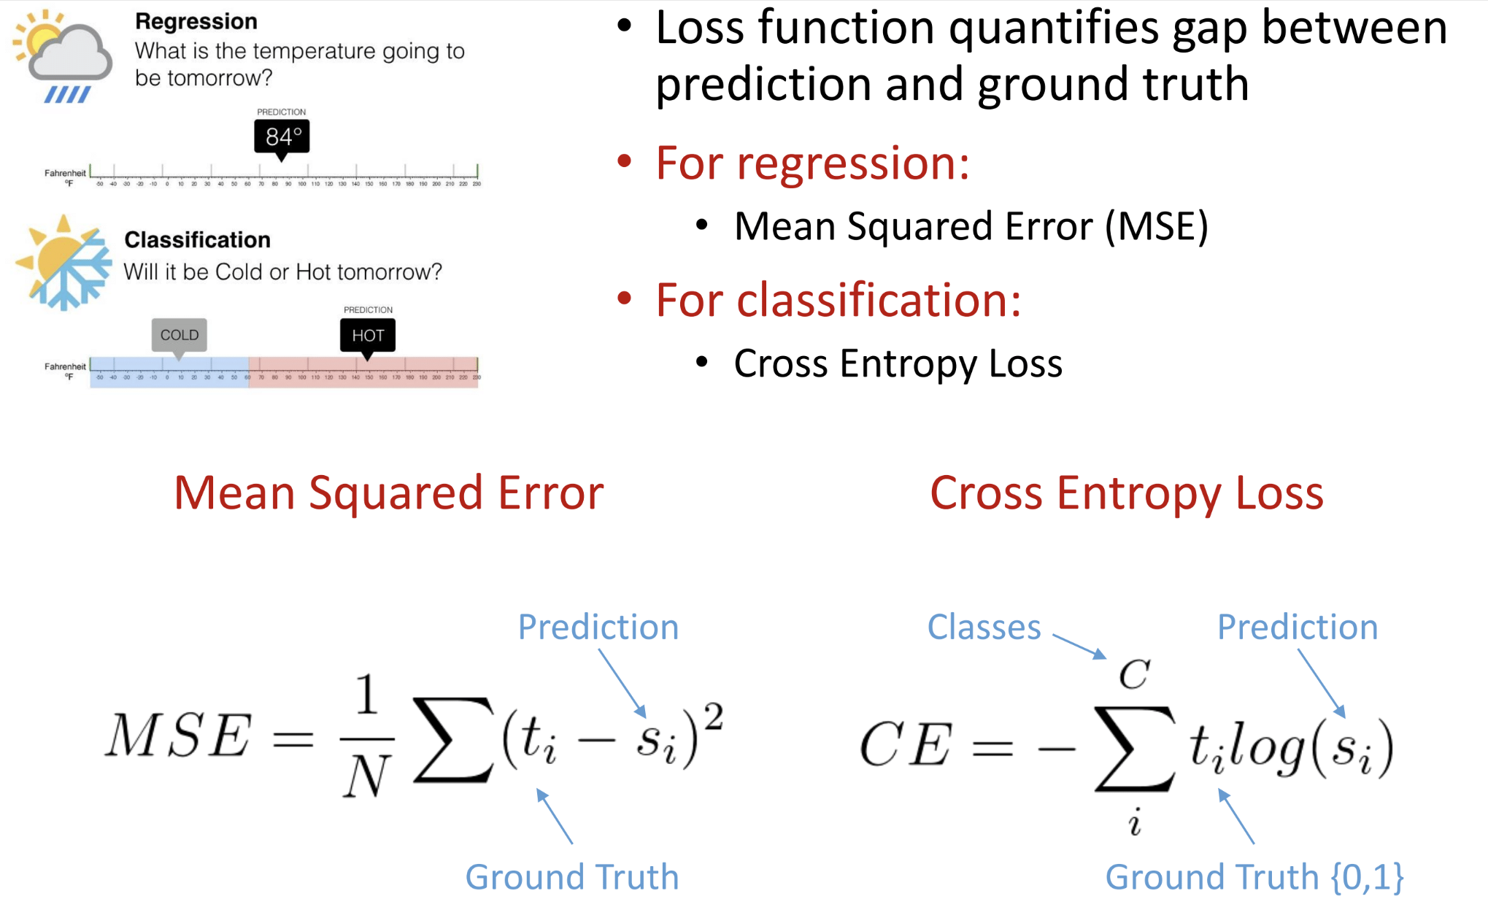
Loss Functions
Notes:
Ground truth is 0-1 or a real number

Slide 52
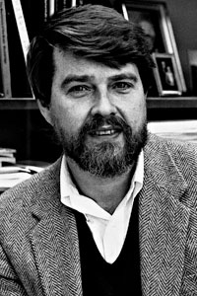
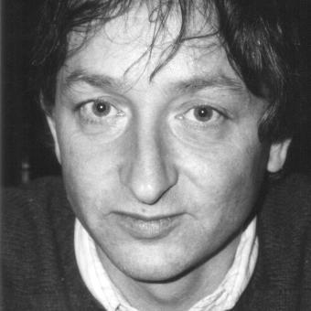
Optimizer - Backpropagation

Slide 53
Stochastic Gradient Descent
Stochastic gradient descent (often shortened to SGD), also known as incremental gradient descent, is an iterative method for optimizing a differentiable objective function, a stochastic approximation of gradient descent optimization

Slide 54
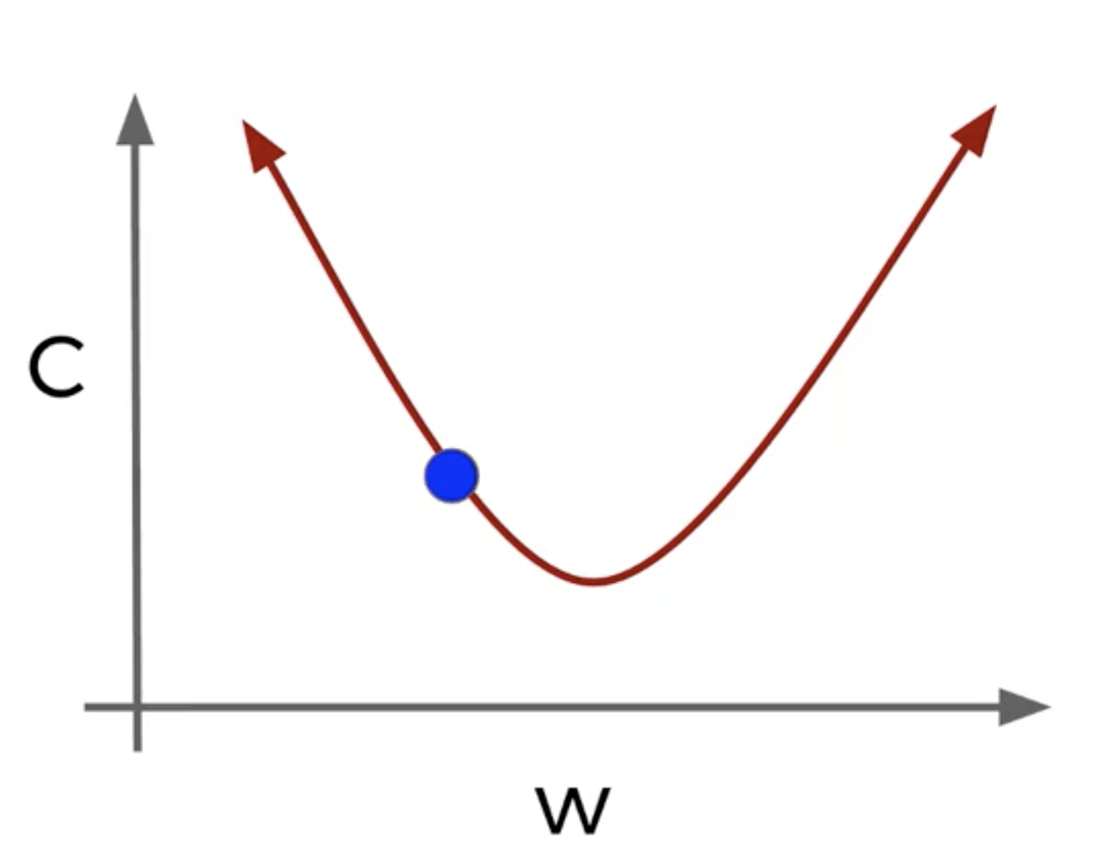
GD in 1 dimension

Slide 55
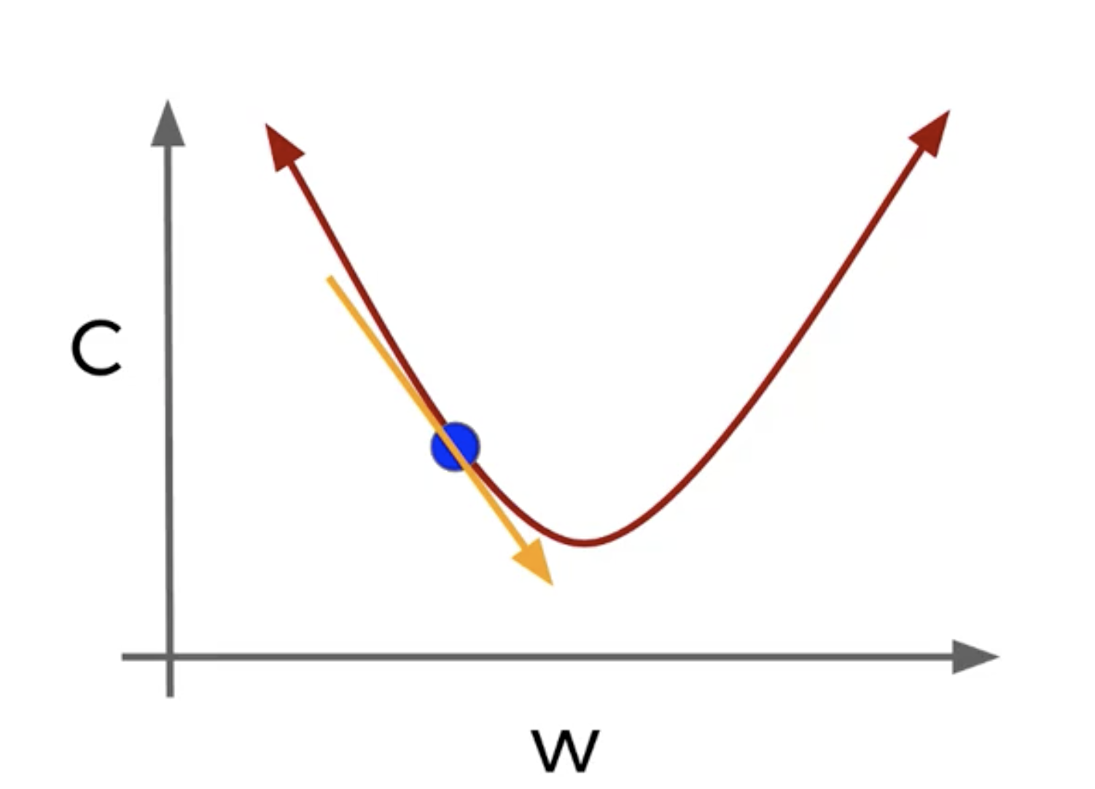
Slope of Tangent line and ‘descend’ along that line
New weight is equal to the old weight subtracted by the slope of the tangent line

Slide 56
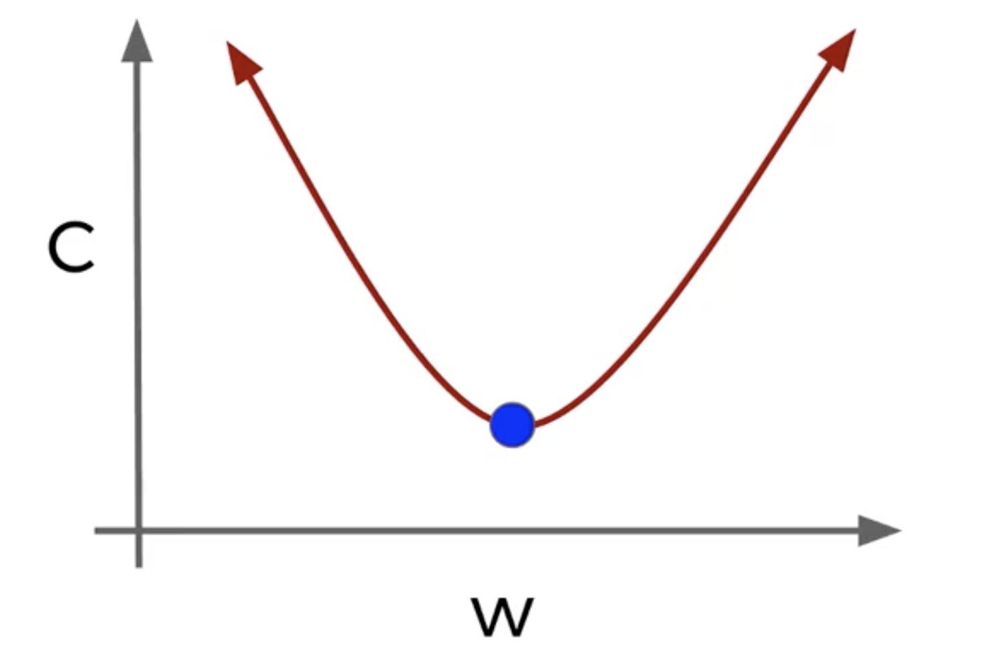
Until we can descent no longer

Slide 57
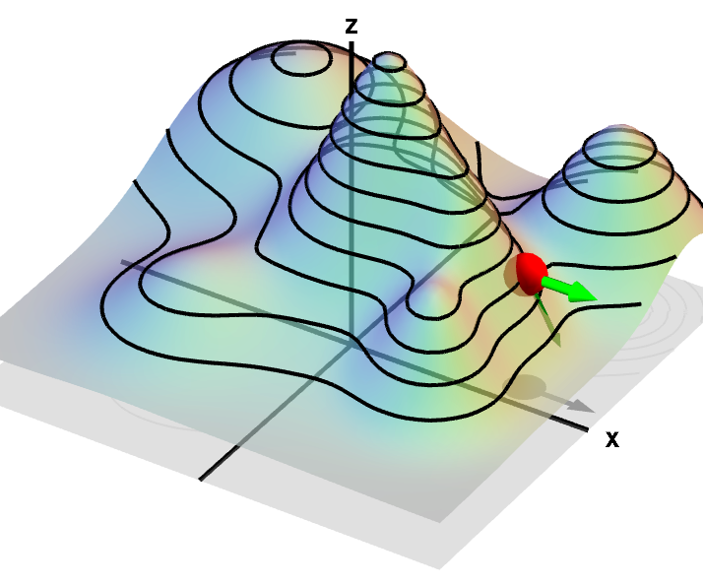
Partial Derivatives
*assume z is the error dimension
The shorted path down is not necessarily along the x or y dimensions, but rather a combination of both - partial derivative

Slide 58
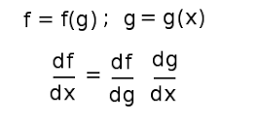
Chain Rule
The derivative of the entire neural network with respect to the input
Is equal to..
The derivative of the entire neural net wrt the previous node and the derivative of the previous node wrt the input
weight
weight
Input
bias
bias

Slide 59

How it works
Forward pass gives you a prediction - and an error
Backward pass gives you a gradient

Slide 60

Different Flavors of SGD (link)

Slide 61
Tensorflow Playground
https://playground.tensorflow.org
Notes:
Simulation - TF written in javascript
Classify dots are blue or orange based on location
Shaded region is the predictions the model is making
Start with slow learning rate
See thickness of the lines, this means the weight it larger
The epoch is just the number of times we are feeding the data through each data point
Show test data checkbox and discretize output (no confidence)
More complicated example - circle pattern
Not making any progress
The shades become very light - the network is confused
Why? Because all we can do it exploit lines
Hover over hidden layers - each neuron has contributed a line
This is why we use deep neural nets - they can exploit more difficult patterns
How else we could have solved them?
What is the formula for circle x2 + y2 = something
Ahh here we get a perfect circle
We have done something called feature engineering - we have identified the right feature and fed it
We can throw all the features at it
We can mouse over the weights and see that the 3-4 features are better
The solutions converged more slowly, this is the penalty for not using the best features
Corner dots
What is the simplest way to solve the corner dots?
Easy!
Interlocking spirals
Throw all features at it!
There is just not enough parameters to play with - it will just never work
This is actually considered a hard problem - lots of problems have interlocking patterns. It's just that we can’t see them
How many parameters with 2 hidden layers? 8 - 5
Is this the best way to do this? No
But we didn’t use polar coordinates or fancy math, just this neural network does the work pretty good
This is actually quite magical, we just threw something at
So this is REALLY just trial and error guided by gradient descent

Slide 62
Simple Example of NN
http://bit.ly/2TAybmD

Slide 63
More Advanced Example
http://bit.ly/2XWKic1

